Slide 1

CLOUD COMPUTING WS 18
Alexandros Konstantakos
Zahid Ibnu Yusuf

Slide 2
What we have done so far for the project?
Create a simple chat application ( Exercise 1)
Deploy it to IBM Bluemix ( Exercise 2 & 3 )
Implement Database ( Exercise 3 )
Implement Watson Tone Analyzer and Visual Recognition ( Exercise 3 )
Implement Redis for multiple instances ( Exercise 4 )

Slide 3
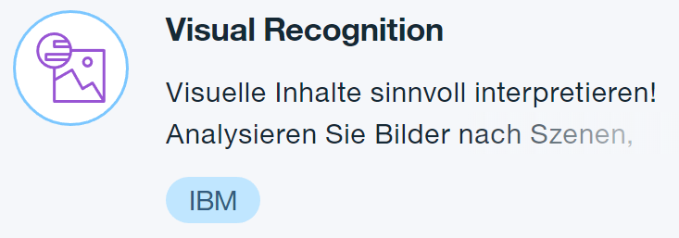
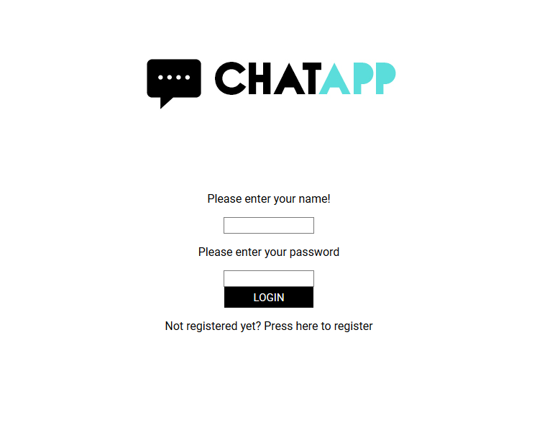
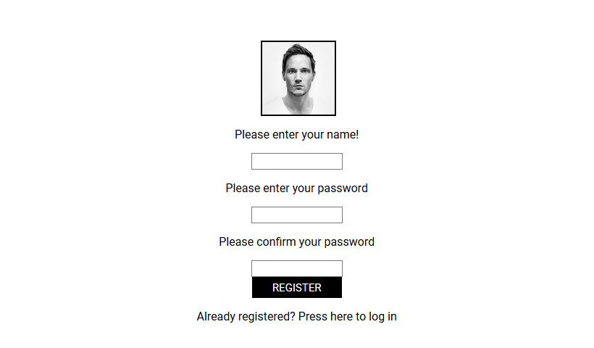
Final Product
Final Login Screen
Final Register Screen

Slide 4
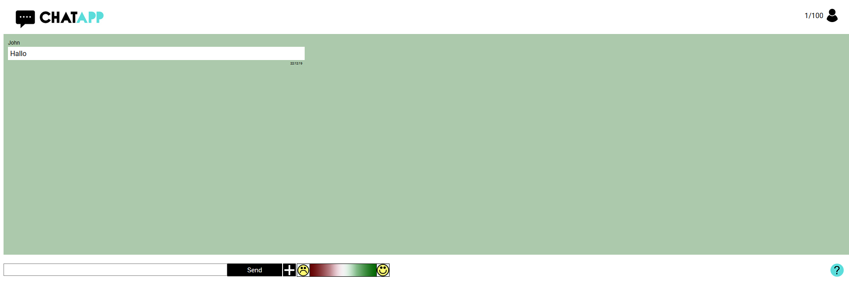
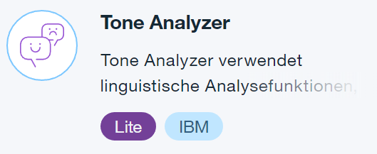
Final Product
Final Chat Room

Slide 5
How it works?
Instance 1
Client
Server
Redis
DB
Instance 2
Client
Server

Slide 6
Lesson Learned
Learn to create an application using Node JS
Learn to deploy an application to IBM Bluemix
Learn to use IBM Watson
Learn to use Cloudant NoSQL DB
Learn to make an application run on multiple instances using redis

Slide 7
Let‘s start with the demo!
Thank you

